Slide 1
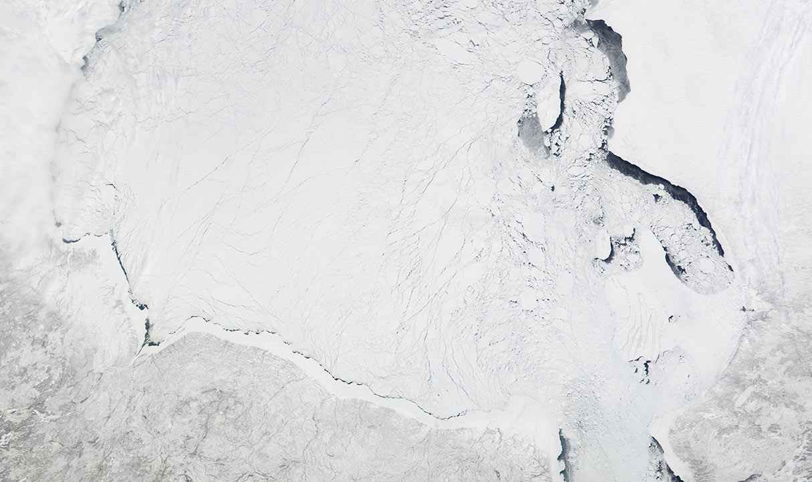




Upirngassaq - Early Spring
Months
March - early April
Sunlight
Days are getting longer
Weather
Snow starts to melt
Ice
More sea ice than any other season.
Lake and sea ice is at its thickest.
Polynyas can freeze over.
Harvest / Wildlife
Female caribou are calving and are therefore not hunted.
Whitefish & char overwinter in lakes but are not usually harvested.
Traditionally families were most hungry because they had few supplies left from the fall and migratory birds had not yet returned.
Sea ice covers Hudson Bay. Ice affects what food sources are available to humans and other animals.

Slide 2
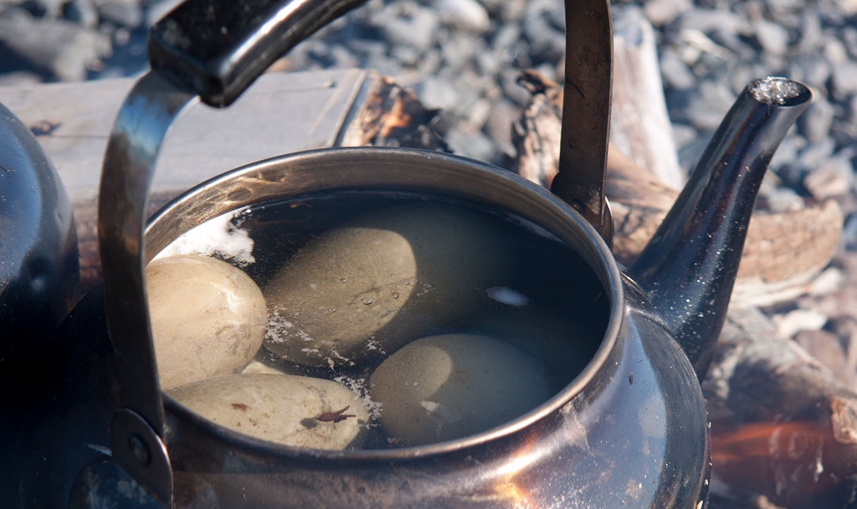
Upirngaaq - Spring
Months
Late April - Early July
Sunlight
Longest day of the year around June 21st (Summer Equinox).
Weather
Warmer weather
Ice
Sea ice starts to break up.
River ice breaks apart.
Harvest / Wildlife
Female caribou are calving and are therefore not hunted.
Whitefish & char overwinter in lakes but are not usually harvested.
Traditionally families were most hungry because they had few supplies left from the fall and migratory birds had not yet returned.
Birds and their eggs are harvested in the spring. Here, eider duck eggs are cooked over a fire.

Slide 3
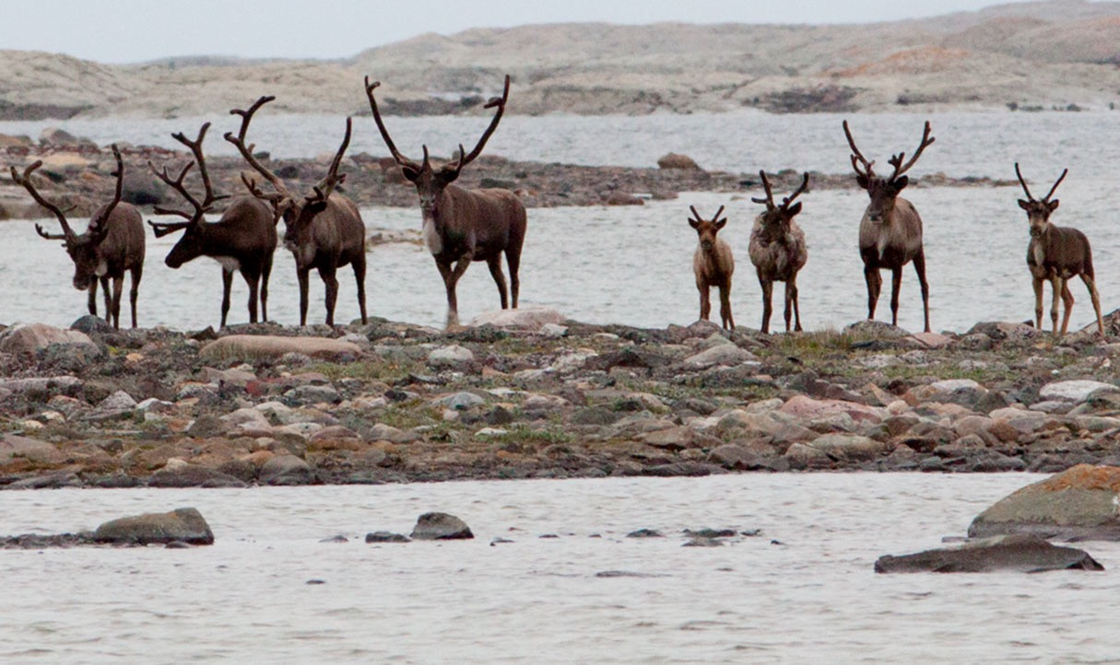
Aujaq - Summer
Months
Mid-July to August.
Sunlight
Days are still long.
Weather
Lots of rain helps tundra plants grow.
Ice
Ice has completely melted.
Harvest / Wildlife
Hunting for caribou on the mainland must be done by boat and ATV because of open water.
Caribou are hunted by boat or ATV during aujaq when there is no ice.

Slide 4
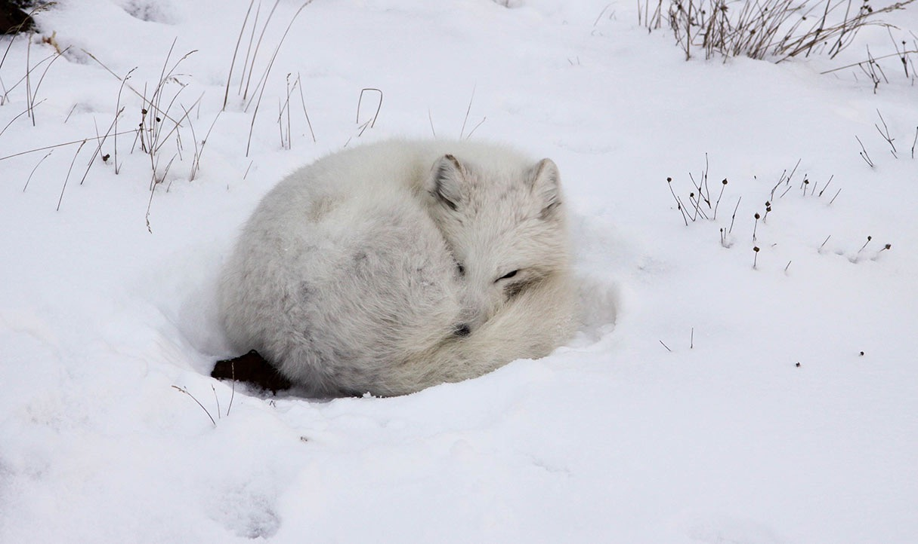
Ukiassaaq - Early Fall
Months
Early September - October
Sunlight
Days start get shorter.
Weather
More rain.
Starting to get colder.
Ice
Lakes & rivers start to freeze.
Harvest / Wildlife
Berries such as crowberries, cranberries, bearberries are ready to pick.
Eider ducks are fat and good to hunt.
An arctic fox is camouflaged against the snow as the ukiassaaq temperatures get colder.

Slide 5
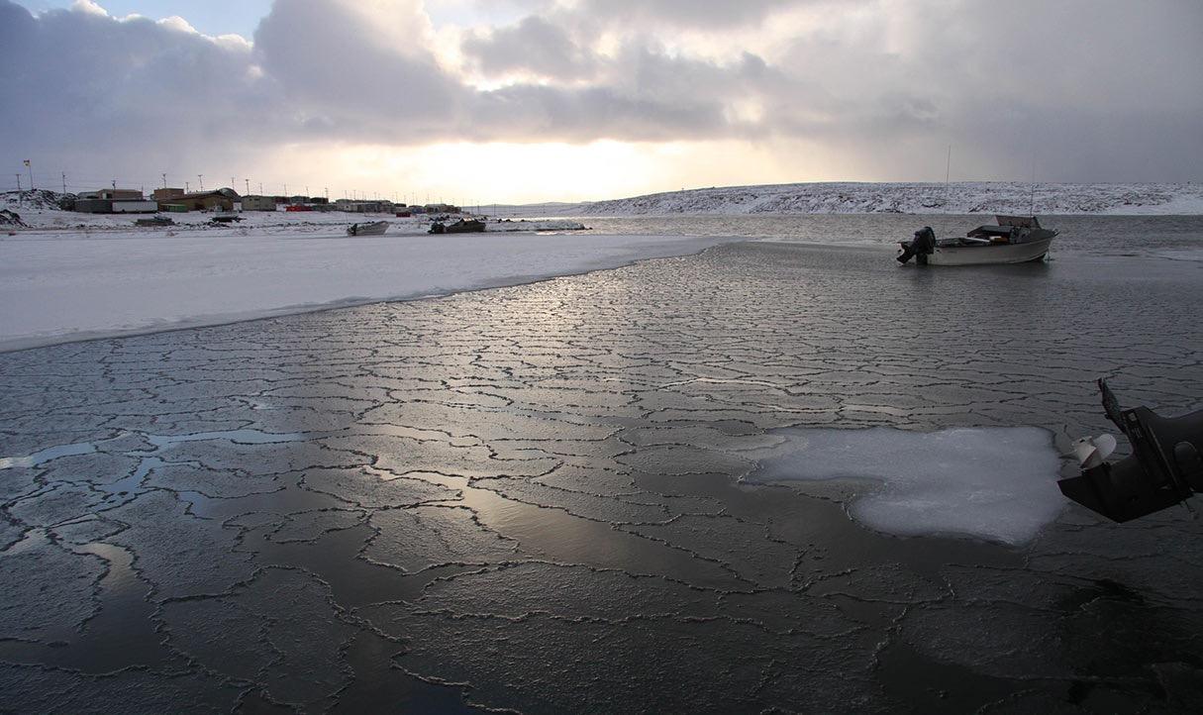
Ukiaq - Fall
Months
November - early December.
Sunlight
Less and less daylight.
Weather
Snow & blowing snow.
Fog.
Ice
Sea Ice begins to freeze.
Harvest / Wildlife
Ice is too dangerous to hunt on.
Whitefish and char are fished.
Eider ducks are hunted.
Ice begins to form on the bay.

Slide 6
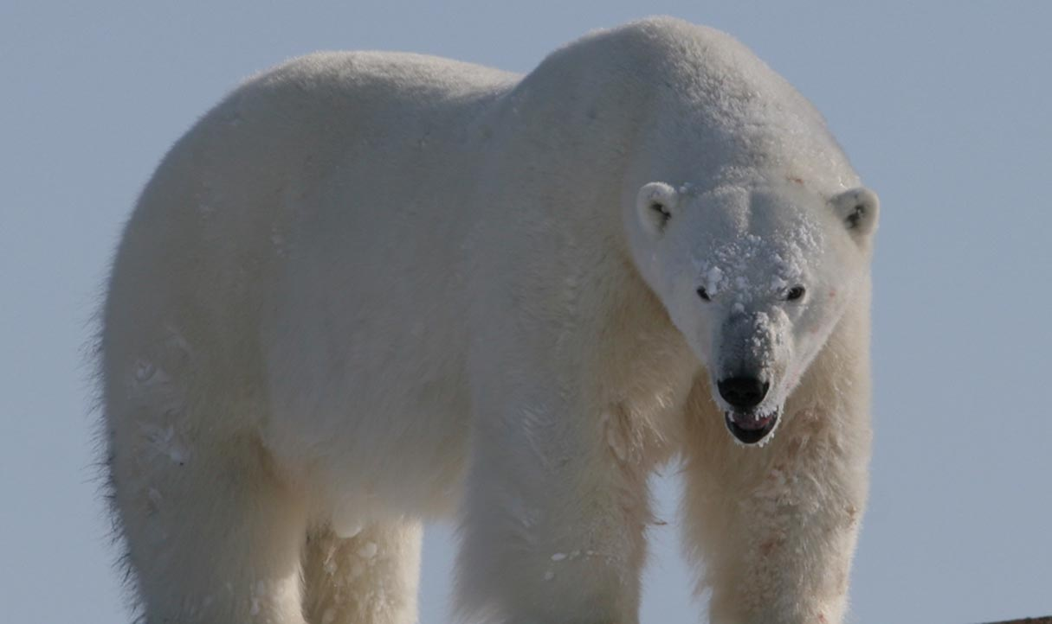
Ukiuq - Winter
Months
Late December - February.
Sunlight
Shortest day of the year around Dec 21, then days begin to get longer.
Weather
Very cold temperatures cause ice fog.
Sunny.
Ice
Ice becomes thick enough for hunters to use their snowmobiles.
Polynya are kept ice free by strong currents.
Harvest / Wildlife
Caribou, reindeer and polar bear hunting is possible on sea ice.
Hunter fish arctic cod though holes in the ice.
Eider ducks and sometimes beluga are found in polynyas.
Seal can be hunted at their breathing holes.
Thick ice in winter makes hunting for large mammals, such as polar bear, possible.

